Slide 1
ICT PROJECT
GROUP MEMBERS:
Mohammad saif haider malik.
Mohammad farooq.
Hissan Waseem.
Sarfraz ali.

Slide 2
Introduction

Slide 3
Introduction
What is github ?
What is Dropbox ?
What are its functions ?
ADVANTAGES AND DISADVANTAGES OF GITHUB and DROPBOX.
PAKISTANS CONTRIBUTION IN GITHUB.

Slide 4
GITHUB
GitHub is an American company that provides hosting for software development version control using Git.
Git is a command line tool.
It provides several features.

Slide 5

Github LOGO

Slide 6
Dropbox
Dropbox is a file hosting service operated by the American company Dropbox.
Offers Cloud Storage.
Dropbox creates a special Folder on the users computer.
Dropbox Stores data.

Slide 7

DROPBOX LOGO

Slide 8
FUNCTIONS OF GITHUB AND DROPBOX

Slide 9
Functions OF github
online service.
remote repository.
Public and private repositories.
Cloning repositories.
Free service limitations.

Slide 10
Some Commands of Git
Git push
Git fetch
Git commit
Git merge
Git Pull
Git Fork
Git Branch

Slide 11
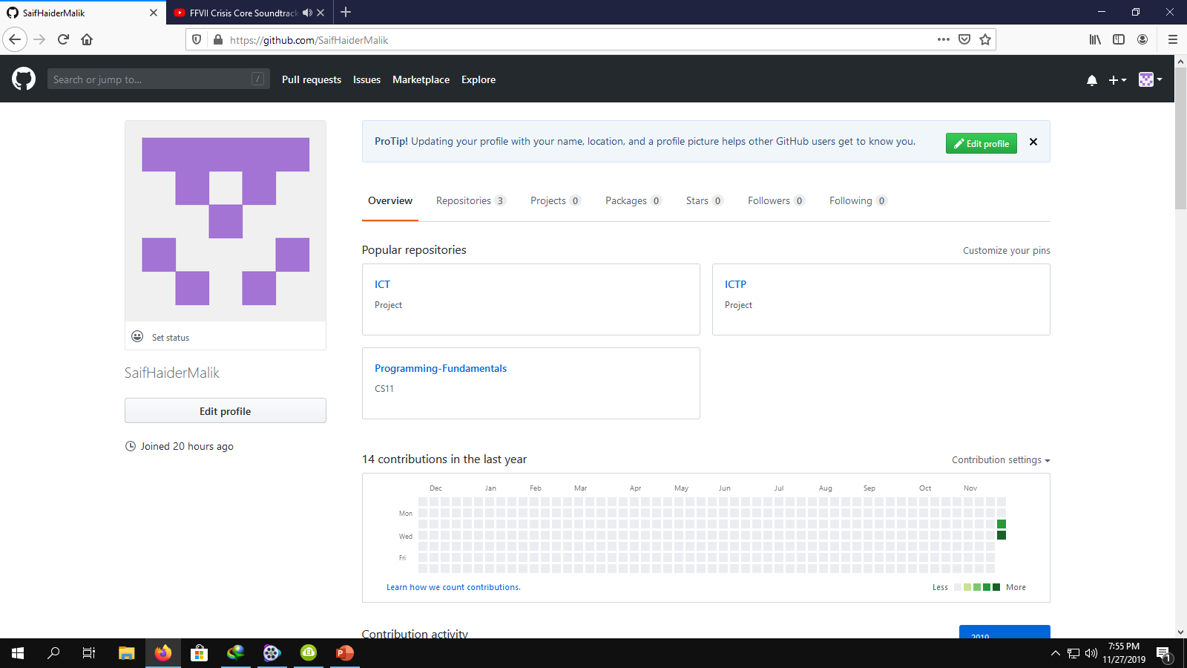
GITHUB PROFILE

Slide 12
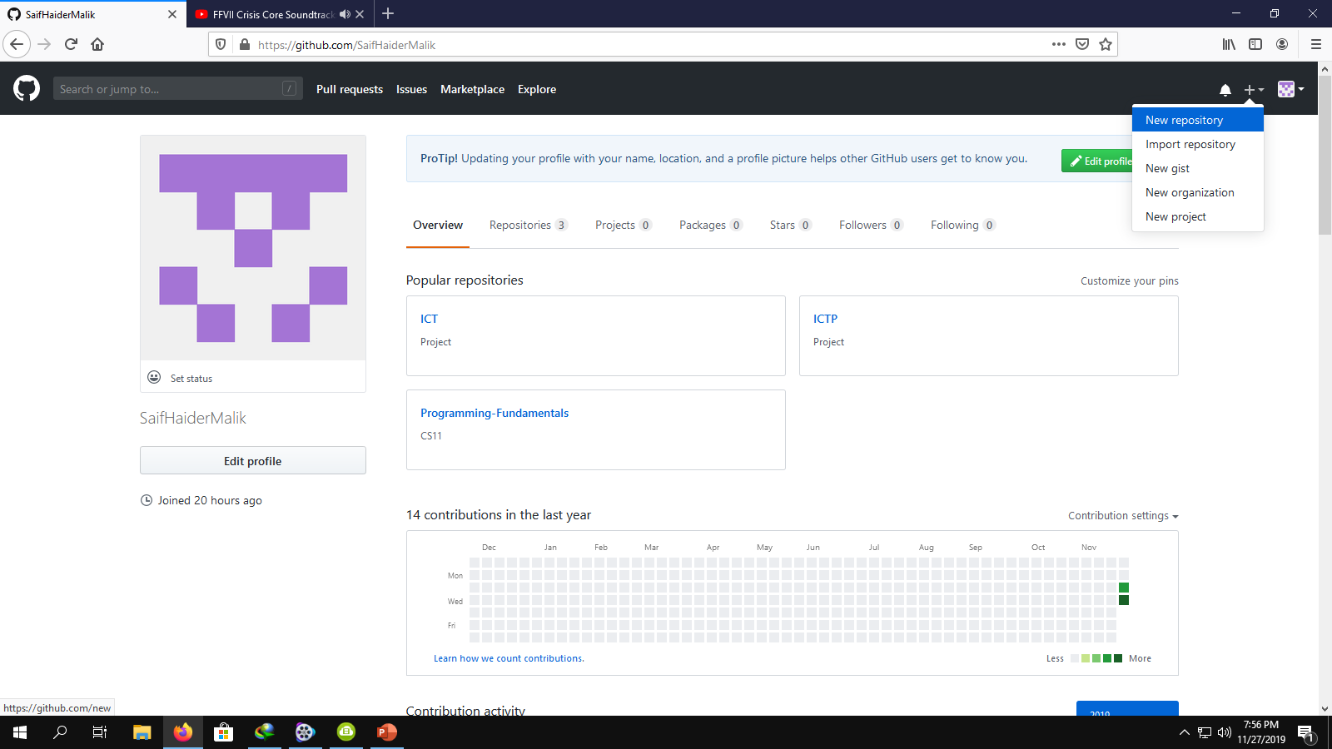
Create A new repository

Slide 13
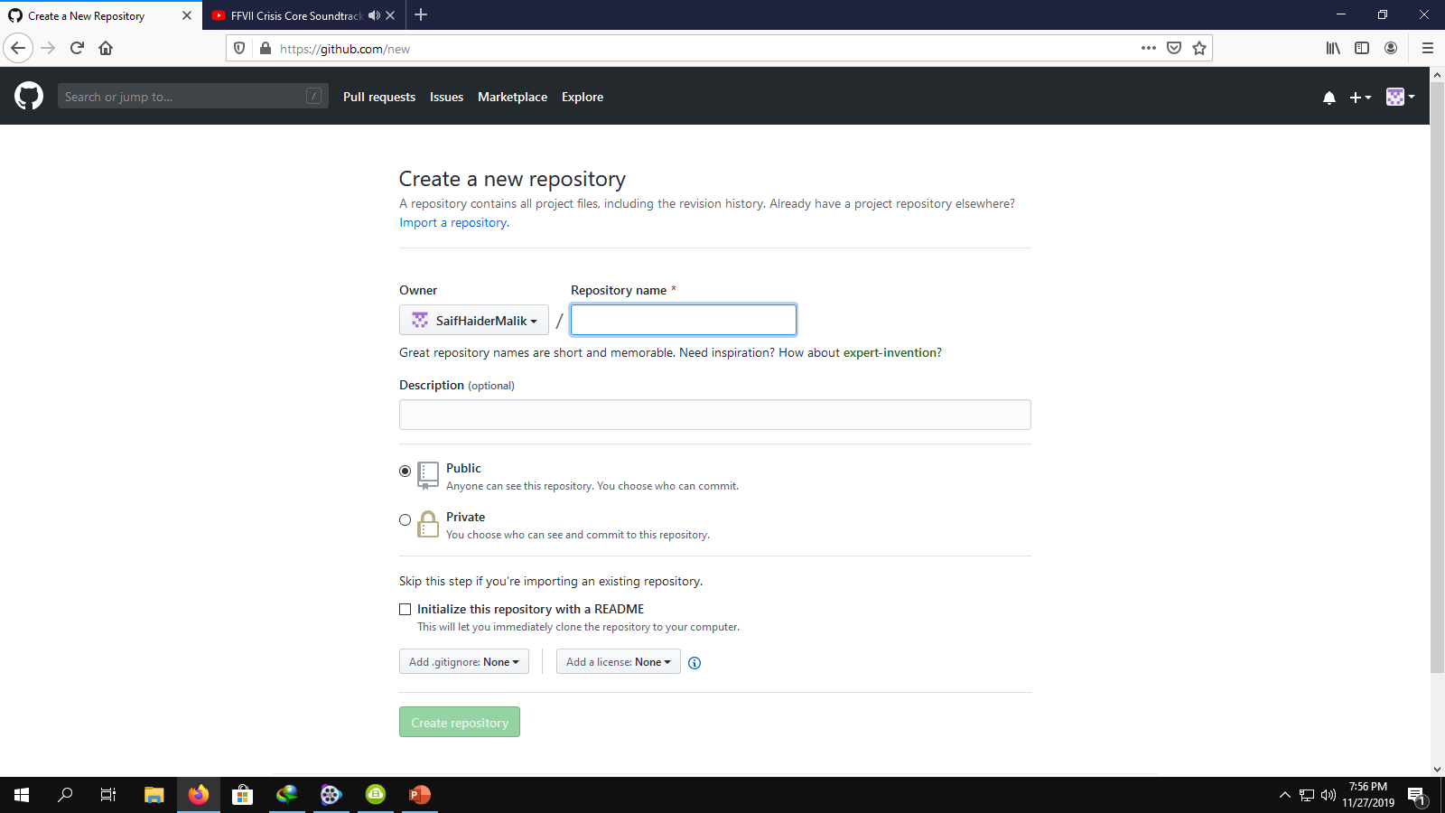
Creating a new repository

Slide 14
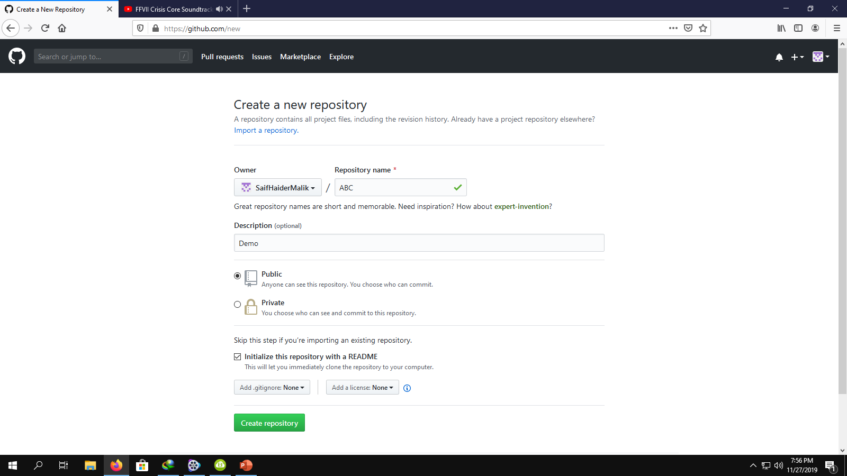
Creating repository

Slide 15
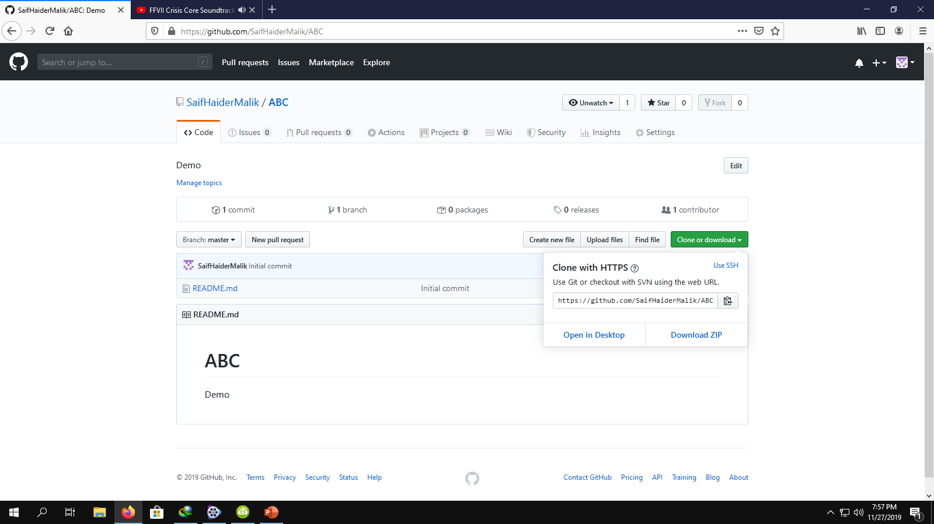
Repository created and its url

Slide 16
Functions of Dropbox
Cloud Storage platform.
Stored Files Can be accessed from a different device.
Keeps File Secured.
Multiple paid tiers.
Smart Sync.
Downloaded state and Online-Only state.

Slide 17
ADVANTAGES AND DISADVANTAGES OF GITHUB

Slide 18
ADVANTAGES OF GITHUB
Github makes it easy to contribute to your open source project.
It offers free services.
It can also work as backup of your project.
Git provides a platform where everyone can share ideas.
It also helps in documentation.

Slide 19
Disadvantages of github
You have to pay for extra features.
Privacy issues.

Slide 20
advantages of drobox
Dropbox is free of cost.
It provides space for storage.
sharing files is possible through drobox.
All stored files can be accessed from different devices.
It can also free your hard disk storage.

Slide 21
Disadvantages of drobox
delete inactive account.
Dropbox cannot be accessed without internet.
There are concerns of privacy issues.

Slide 22
PAKISTANS CONTRIBUTION ON GITHUB

Slide 23
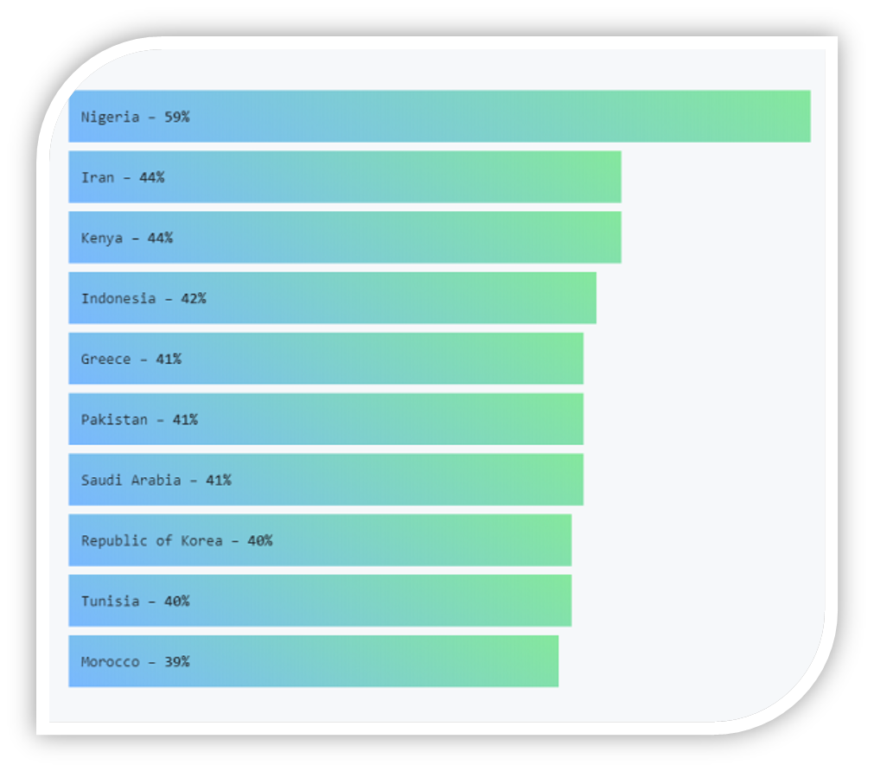

Slide 24
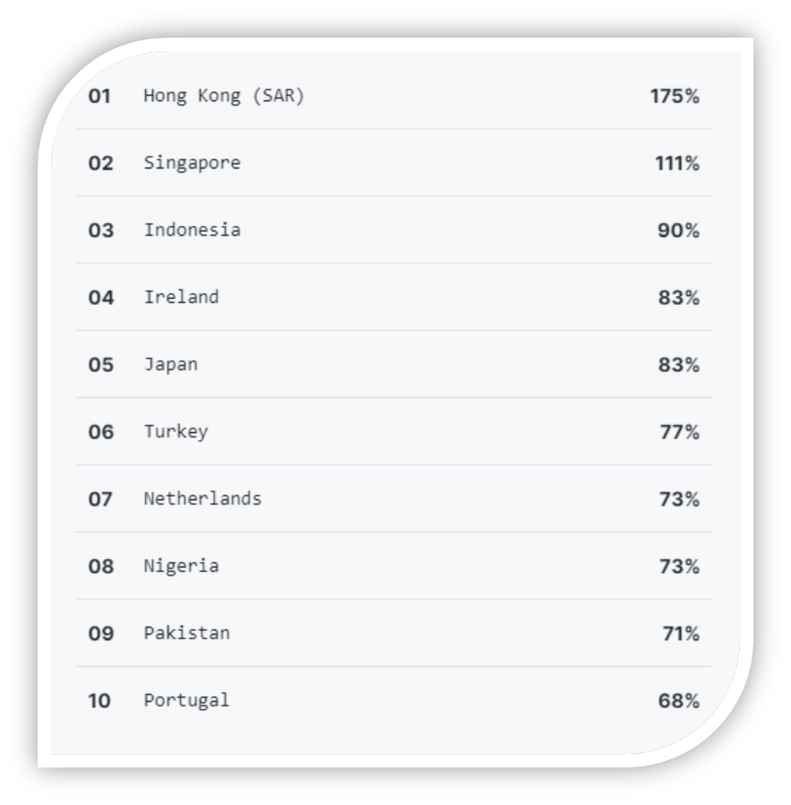

Slide 25
Pakistan is Among The Top 10 Fastest Growing Open Source Contributors on GitHub
Pakistan ranked in top 10 countries (Fastest growing open source community).
Pakistan was tied with Greece and Saudi Arabia for the 5th position.
In terms of total contributors (developers that share their codes at GitHub), Pakistan was ranked in 9th place.

Slide 26
Want to learn more about Dropbox & GitHub?
Dropbox website: https://www.dropbox.com/
YouTube Video: https://www.youtube.com/watch?time_continue=1&v=WRrBE28KTXI
GitHub website: https://github.com/
YouTube Video: https://www.youtube.com/watch?v=xuB1Id2Wxak

